Slide 1
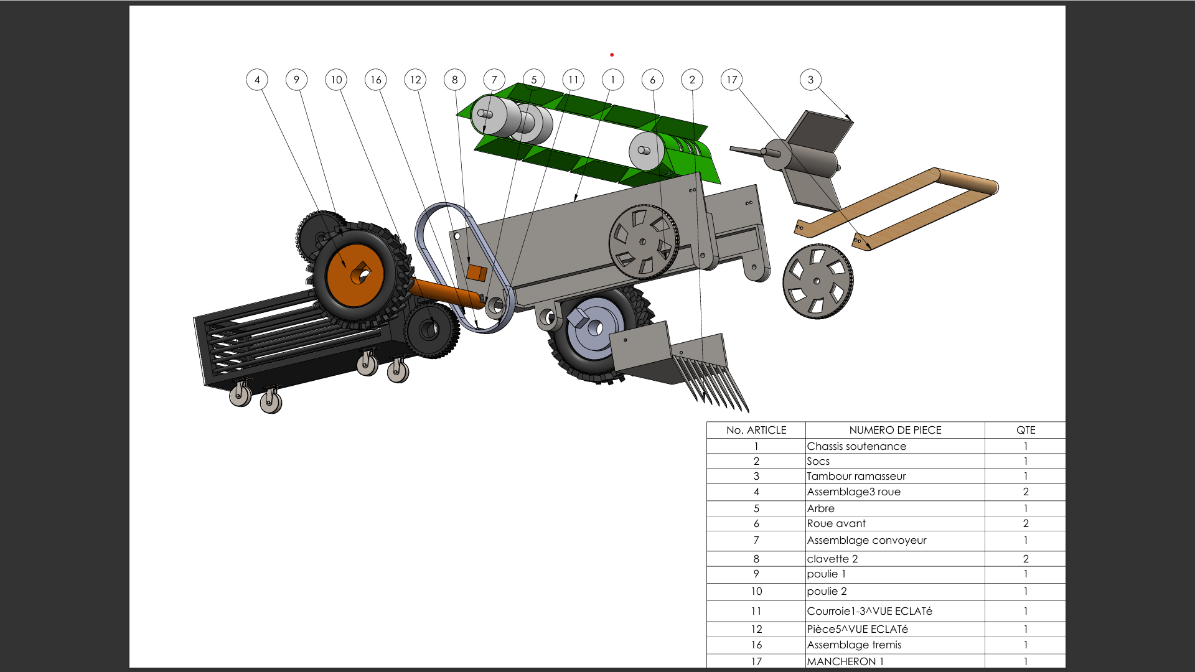
Project Presentation
Project name : Multifunctional harvesting for Onion, Carrot, Lettuce.
Problem Statement: Lack of mechanisation, Difficult access to imported machinery, Inadequacy of machinery and Post-harvest losses.
Innovative Solution: An affordable, locally made harvester to efficiently collect onions, carrots, and lettuce
Expected Outcome: Reduce labor costs and harvesting time for smallholder farmers and reduce crop losses and improve post-harvest efficiency.

